Slide 1

CYBERSECURITY FUNDAMENTALS
2026
Cybersecurity
Fundamentals
Blue & Red Teams • SOC Operations • Privacy • Security Controls
Authentication & Authorization
Defense Strategies
Team Operations
Access Control

Slide 2
PRESENTATION OVERVIEW
Contents
01
Blue & Red Teams
02
Security Operations Center
Offensive vs defensive security operations and the Purple Team collaborative approach
SOC functions, structure, and 24/7 threat monitoring capabilities
03
SOC Job Roles
04
Privacy & Data Protection
Three-tier analyst structure and specialized security positions
CIA Triad foundation and privacy principles guiding security strategies
05
Security Controls
06
Authentication Methods
Comprehensive framework of administrative, technical, and physical controls
Identity verification factors and multi-factor authentication approaches
07
Authorization & Access Control
RBAC, MAC, DAC, and ABAC models for controlling resource access

Slide 3
OFFENSIVE VS DEFENSIVE SECURITY
Blue Team vs. Red Team
Two sides of the same mission: testing and strengthening organizational defenses
RED TEAM
BLUE TEAM
Offensive Security
Defensive Security
Objective
Objective
Simulate real-world adversaries to find and exploit vulnerabilities. Think like attackers to uncover weaknesses before malicious actors do.
Protect organizational assets, detect threats in real-time, and respond to security incidents to minimize damage and prevent breaches.
Key Activities
Key Activities
• Penetration testing & vulnerability exploitation
• 24/7 security monitoring & threat detection
• Social engineering & phishing campaigns
• Incident response & containment
• Privilege escalation & lateral movement
• Security tool management & tuning
• Physical security bypass attempts
• Vulnerability management & patching
Tools Used
Tools Used
Metasploit, Cobalt Strike, Burp Suite, custom exploits, phishing frameworks
SIEM (Splunk, QRadar), EDR/XDR, firewalls, IDS/IPS, threat intelligence platforms
Success Metric: Systems compromised, objectives achieved
Success Metric: Mean time to detect/respond, attacks blocked
Key Insight: Red Team exercises are time-boxed (weeks/months) while Blue Team operations are continuous. Both teams ultimately serve the same goal: improving organizational security posture.

Slide 4
COLLABORATIVE SECURITY
Purple Team: Bridging Offense & Defense
The collaborative approach that maximizes security effectiveness through knowledge sharing
What is Purple Teaming?
Purple Team Benefits
Purple Team is not a separate team but a collaborative function that brings Red and Blue teams together to share knowledge, improve communication, and enhance overall security posture.
Knowledge Transfer
Red Team shares attack techniques; Blue Team shares detection capabilities. Both teams learn and improve.
Unlike traditional adversarial exercises, Purple Team operations emphasize real-time knowledge transfer and cooperative improvement.
Faster Improvement
Real-time feedback loops allow immediate adjustments to both attacks and defenses during exercises.
Core Functions
Gap Identification
Documentation & Process Improvement
Quickly identify where detection is missing and where controls need strengthening.
Assess and improve documentation, communication protocols, and response procedures
Strategic Recommendations
Cost Efficiency
Develop actionable insights for identifying and responding to future threats
Maximize value from security testing by ensuring findings are immediately actionable.
Continuous Improvement
Apply lessons learned to create strategies for ongoing security enhancement
Remember:
"Purple Team" can also be a verb — describing the collaborative activity of Red and Blue teams working together to improve security.

Slide 5
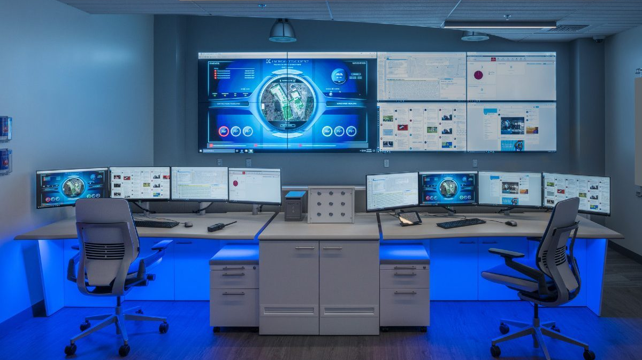
SECURITY OPERATIONS
Security Operations Center (SOC)
The central nervous system of organizational cybersecurity
What is a SOC?
Core SOC Functions
A Security Operations Center (SOC) is a centralized team, facility, and organizational capability responsible for continuously monitoring, detecting, analyzing, and responding to cybersecurity incidents.
Continuous Monitoring
Monitor networks, systems, and applications for security events and anomalies using SIEM and other tools
The SOC serves as the first line of defense against cyber threats, operating 24/7 to protect an organization's digital assets, infrastructure, and sensitive data.
Threat Detection
Identify potential security incidents through alert analysis, log review, and threat intelligence correlation
24/7 Operations
Incident Response
24/7
365
<15
Investigate, contain, eradicate, and recover from security incidents following established procedures
Continuous Monitoring
Days Per Year
Min Response Time
SOCs operate around the clock because cyber threats don't follow business hours. Global coverage ensures someone is always watching.
Threat Hunting
Proactively search for advanced threats that evade automated detection systems
Reporting & Compliance
Document incidents, generate reports, and ensure compliance with regulatory requirements

Slide 6
ORGANIZATIONAL STRUCTURE
SOC Team Structure & Job Roles
A tiered approach to handling security incidents from detection to advanced response
L1
TIER 1
L2
TIER 2
L3
TIER 3
Triage Specialist
Incident Responder
Threat Hunter
Primary Role
Primary Role
Primary Role
First line of defense - monitor alerts and perform initial triage
Deep investigation and incident response coordination
Proactive threat hunting and advanced response
Key Responsibilities
Key Responsibilities
Key Responsibilities
• Monitor SIEM dashboards 24/7
• In-depth log analysis
• Advanced threat hunting
• Initial alert triage & classification
• Threat intelligence correlation
• APT detection & analysis
• Identify false positives
• Determine scope & impact
• Reverse engineering
• Escalate confirmed incidents
• Coordinate containment
• SIEM rule development
• Basic threat analysis
• Malware analysis
• Penetration testing
Tools
Tools
Tools
SIEM, EDR, ticketing systems
Forensics tools, threat intel platforms
MITRE ATT&CK, IDA Pro, YARA
"Eyes on Glass"
"Cyber Sleuths"
"Proactive Defenders"
SOC Manager
Security Engineer
Threat Intel Analyst
CISO
Oversees operations, manages staff, reports to CISO, handles budgets and compliance
Maintains security tools, configures SIEM, develops automation, manages infrastructure
Researches threats, maintains IOCs, provides context for investigations
Strategic leader defining security vision, policies, and reporting to executive management

Slide 7
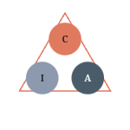
DATA PROTECTION FOUNDATION
Privacy: The CIA Triad Foundation
The three pillars that guide all information security and privacy practices
The CIA Triad (Confidentiality, Integrity, Availability) is the foundational model for information security. These three principles guide how organizations protect valuable assets and ensure data privacy.
Confidentiality
Definition: Keeping data secret from unauthorized individuals, entities, or processes. Only authorized parties can access sensitive information.
Controls: Encryption, access controls, authentication, VPNs
Threats: Unauthorized access, eavesdropping, data breaches
CIA
Integrity
TRIAD
Definition: Ensuring data accuracy, consistency, and trustworthiness throughout its lifecycle. Data cannot be altered undetected.
Controls: Hashing, digital signatures, version control, audit logs
Threats: Data tampering, corruption, man-in-the-middle attacks
Referenced in ISO 27001, GDPR, PCI-DSS, and NIST standards
Availability
Balancing Act
Definition: Ensuring systems and data are accessible and usable when needed by authorized users. No value if data is inaccessible.
The three elements sometimes conflict. Strong confidentiality measures may reduce availability. The right balance depends on organizational requirements and risk tolerance.
Controls: Redundancy, backups, disaster recovery, DDoS protection
Threats: DDoS attacks, hardware failures, ransomware, disasters

Slide 8
DEFENSE MECHANISMS
Security Controls Framework
A comprehensive taxonomy of safeguards and countermeasures protecting organizational assets
Three Categories of Controls
Administrative
Technical/Logical
Physical
Policies, procedures, and guidelines that define security practices
Software and hardware-based controls protecting systems and data
Controls protecting physical access to facilities and equipment
Examples: Security policies, training, background checks, incident response plans
Examples: Firewalls, encryption, antivirus, SIEM, access controls
Examples: Locks, guards, CCTV, biometrics, mantraps, fences
Seven Functional Types of Controls
Preventive
Detective
Corrective
Deterrent
Stop incidents before they occur
Identify incidents when they occur
Fix damage after an incident
Discourage potential attackers
Ex: Firewalls, access controls, encryption
Ex: SIEM, IDS, audit logs, CCTV
Ex: Patches, incident response, isolation
Ex: Warning banners, security signs
Directive
Recovery
Compensating
Guide behavior toward security
Restore systems after incidents
Alternative controls when primary controls are not feasible
Ex: Policies, procedures, signage
Ex: Backups, DR plans, system rebuilds
Ex: Additional monitoring when encryption isn't possible
Defense in Depth Strategy
Effective security requires layered controls across all categories and types. No single control is sufficient—multiple overlapping controls provide comprehensive protection.

Slide 9
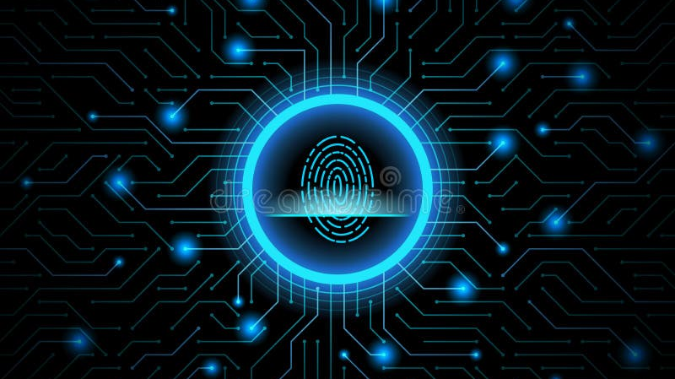
IDENTITY VERIFICATION
Authentication: Verifying Identity
The process of confirming that users are who they claim to be
What is Authentication?
Multi-Factor Authentication
Authentication is the security process of verifying the identity of a user, device, or system attempting to access resources. It's the first line of defense in access control.
MFA / 2FA
What is MFA?
Authentication answers the question: "Are you who you say you are?"
MFA requires users to provide two or more authentication factors from different categories before granting access.
The Three Authentication Factors
99.9%
of automated attacks blocked
Something You KNOW
Microsoft research shows MFA blocks nearly all automated account takeover attempts
Knowledge-based factors that only the user should know
Passwords, PINs, security questions
Common MFA Combinations
• Password + SMS code (2FA)
Something You HAVE
• Password + Authenticator app
• Password + Biometric + Token (3FA)
Possession-based factors that only the user should possess
Smart cards, tokens, mobile devices
Best Practice
Something You ARE
Never rely on single-factor authentication for sensitive systems. MFA should be mandatory for all privileged accounts and remote access.
Inherence-based factors based on unique biological characteristics
Fingerprints, facial recognition, iris scan

Slide 10
AUTHENTICATION TECHNOLOGIES
Authentication Methods in Practice
Specific technologies and approaches for verifying identity
Password-Based
Token-Based
Biometric
Description
Description
Description
User provides a secret string known only to them
Physical or digital device generating one-time codes
Unique physical or behavioral characteristics
Strengths
Types
Types
Simple to implement, widely supported, no special hardware
• Hardware tokens: YubiKey, RSA SecurID
• Fingerprint: 99.9% accuracy
Weaknesses
• Software tokens: Google Authenticator
• Facial recognition: Hands-free access
Vulnerable to phishing, brute force, credential reuse
• SMS codes: Text message OTP
• Iris/Retina: High-security environments
• Push notifications: App-based approval
• Voice recognition: Phone banking
Best Practices
Strengths
• Behavioral: Typing patterns, gestures
• Minimum 12-16 characters
Stronger than passwords alone, widely available
Strengths
• Mix of character types
Weaknesses
Convenient, difficult to share or steal, unique
• No dictionary words
SMS vulnerable to SIM swapping, hardware can be lost
Weaknesses
• Unique per account
Privacy concerns, cannot be changed if compromised
Security: Low-Medium
Security: Medium-High
Security: High
Certificate-Based
Passwordless
Description
Description
Digital certificates issued by Certificate Authority (CA)
Eliminates passwords entirely using alternative factors
Comparison Matrix
How It Works
Approaches
Public-private key cryptography verifies identity
• FIDO2/WebAuthn standards
Security Strength
Biometric > Certificate > Token > Password
Use Cases
• Biometric + device possession
VPN access, email signing, device authentication
• Magic links via email
User Convenience
Biometric > Passwordless > Token > Password
• Mobile app push notifications
Strengths
Strengths
Implementation Cost
Password < Token < Biometric < Certificate
Strong security, scalable, automated
No password fatigue, resistant to phishing, better UX
Challenges
Legacy system support, user education required
Security: High
Security: Very High

Slide 11
ACCESS CONTROL
Authorization: Controlling Access
Determining what authenticated users can do and which resources they can access
Authentication vs. Authorization
DAC - Discretionary Access Control
Most Flexible
Resource owners decide who can access their resources
Authentication
Authorization
Example: File sharing - you control who sees your documents
Question: "Are you who you say you are?"
Question: "What are you allowed to do?"
Purpose: Verifies identity
Purpose: Controls access rights
ABAC - Attribute-Based Access Control
Most Dynamic
Key Principle: Authentication always comes before authorization. You must prove who you are before the system can determine what you can access.
Access based on attributes of user, resource, and environment
Example: "Engineers can access prod servers only during business hours from company network"
Key Authorization Principles
Authorization Models
•Least Privilege: Users get minimum access needed
•Need-to-Know: Access only to information required for job
•Separation of Duties: Critical actions require multiple people
RBAC - Role-Based Access Control
Most Common
Access based on user's role within the organization
Example: "Managers can approve expenses up to $5,000"
Model Comparison
MAC - Mandatory Access Control
Highest Security
Model | Flexibility | Security | Complexity
RBAC | Medium | Medium-High | Low
MAC | Low | Very High | High
DAC | High | Low-Medium | Low
ABAC | Very High | High | Very High
Access enforced by system based on security labels/clearances
Example: Military classifications (Top Secret, Secret, Confidential)

Slide 12
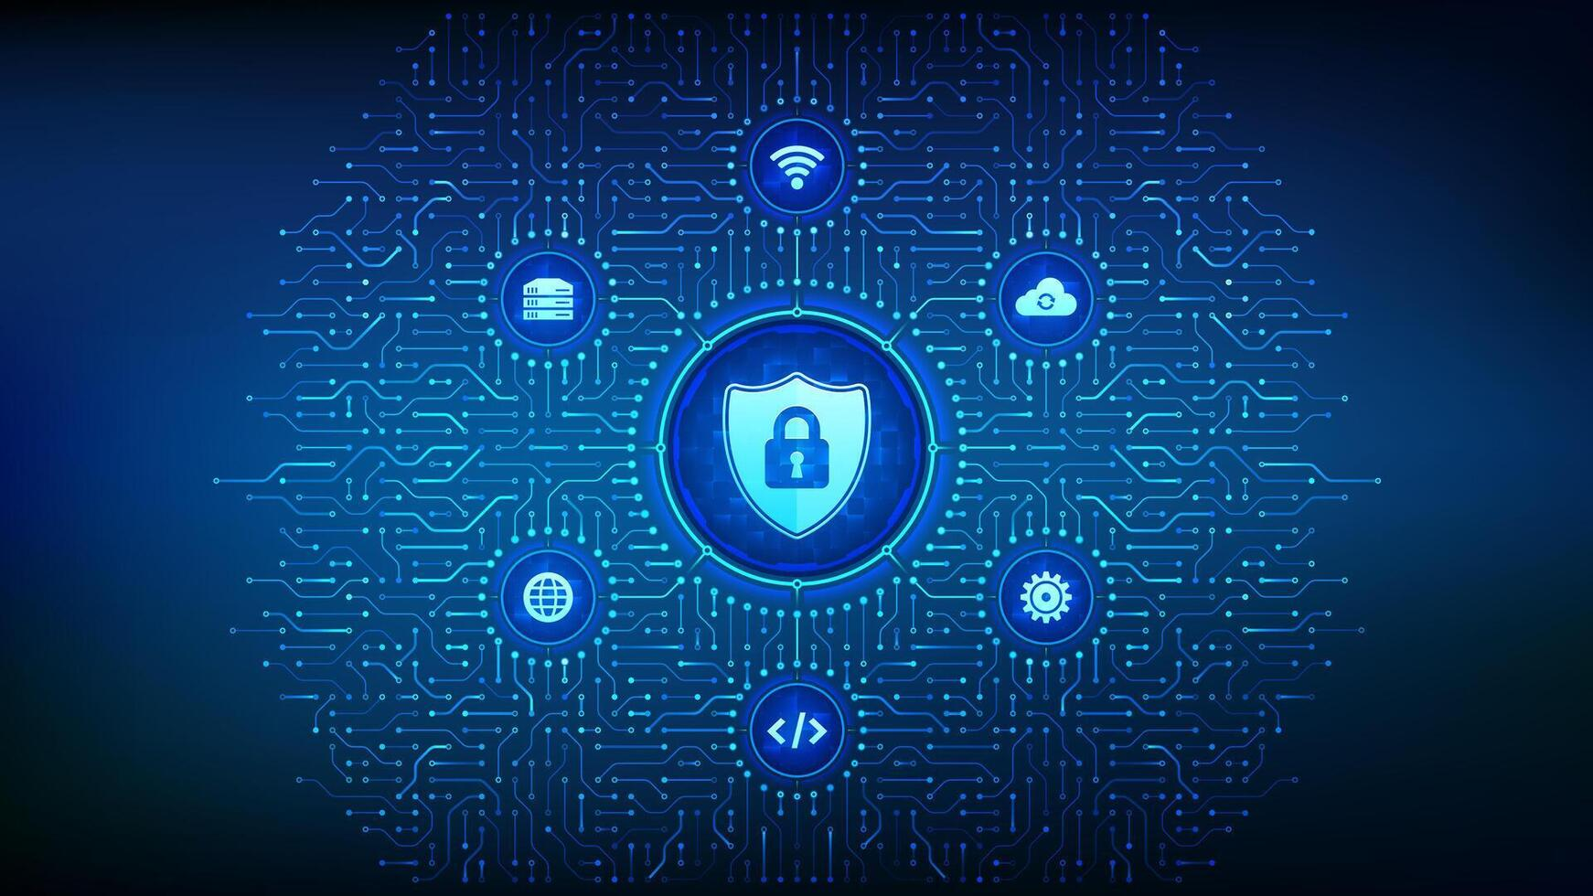
Building a Security-First Culture
Cybersecurity is not just about tools and technologies—it's about people, processes, and continuous improvement.
By understanding these fundamental concepts, organizations can build resilient defense mechanisms and foster a culture where security is everyone's responsibility.
Teamwork
Vigilance
Defense in Depth
Continuous Learning
Red, Blue, and Purple teams working together
24/7 monitoring and proactive threat hunting
Multiple layers of security controls
Adapting to evolving threats
Secure by Design
Privacy First
Trust & Verify

